Slide 1
COMP8715
The Cinema Project

Slide 2
Table of Contents
01
Introduction
06
05
Teamwork
02
Project Output
Communication
03
07
Demos
Reflection
04
Decision Making

Slide 3
01
Introduction
By Yixian Qiu

Slide 4
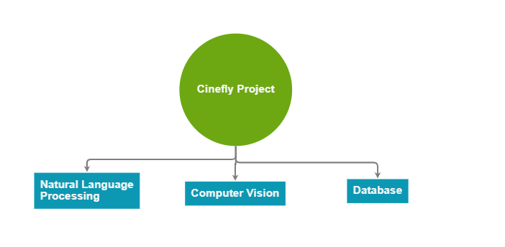
Main Tasks
extract information from videos
put this information into a database

Slide 5
02
Project Output
By Tao Qu

Slide 6
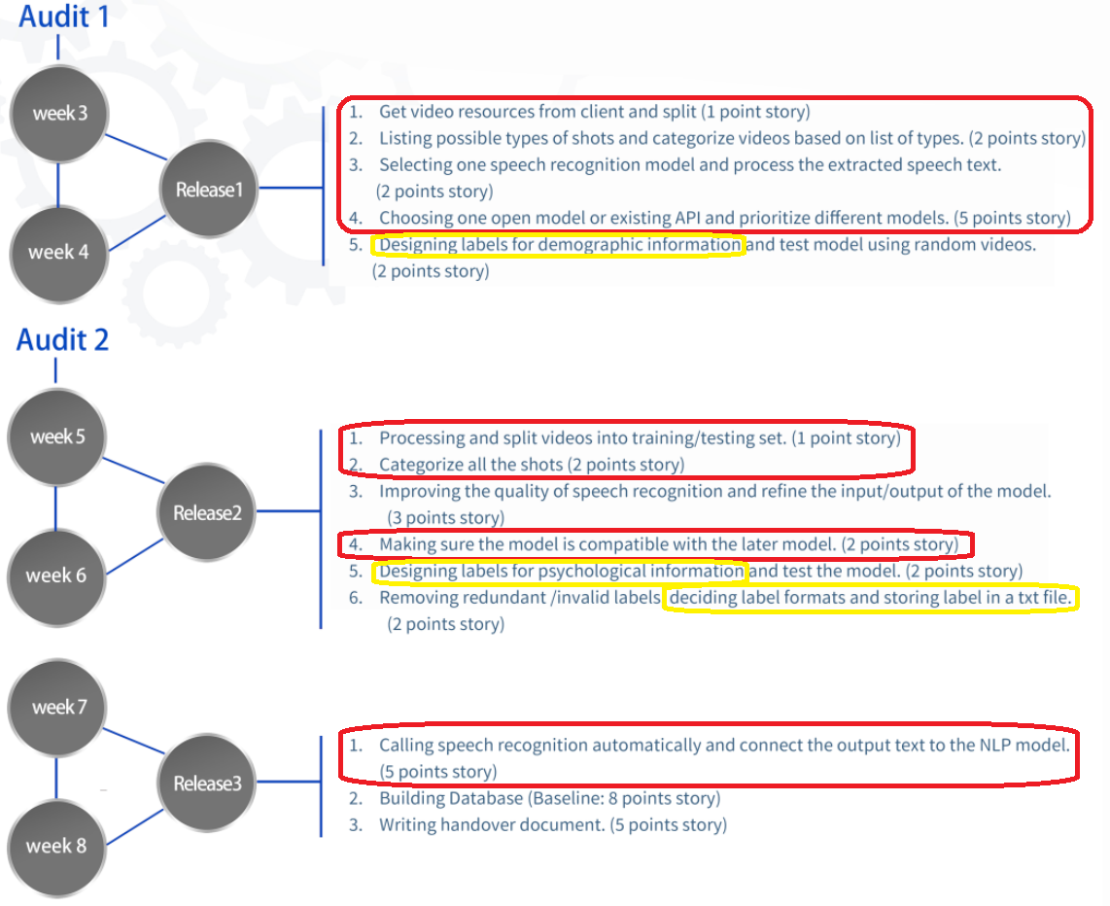
Project Progress
Former Timeline

Slide 7
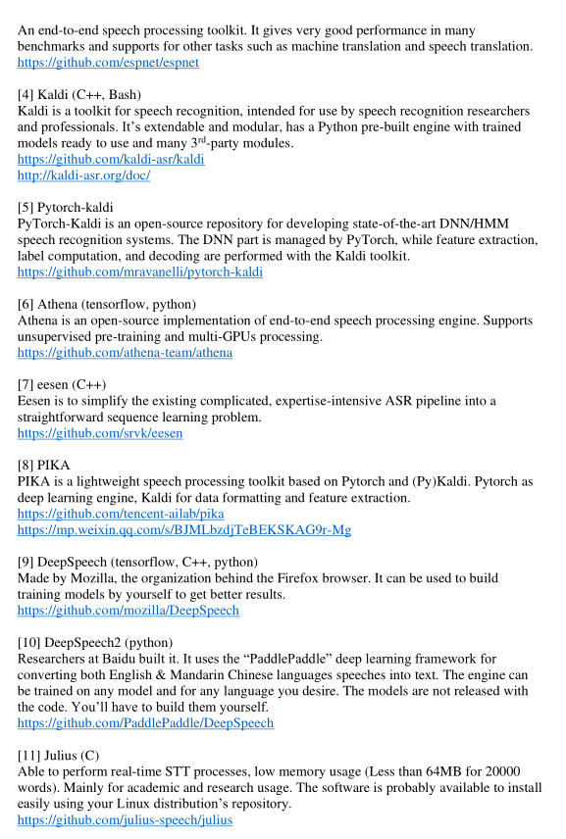
Project Deliverables
Standardize input videos: each video should be split into different shots.
Speech recognition and extraction: produces text of speeches in videos.
An algorithm of processing demographic info.(E.g., name, gender, age)
A research document: in comparison of differences between the performance and functions of various APIs and open-source algorithms.
API Research Report
Current Achievements

Slide 8
Project Roadmap
Phase 3
(Before week 13)
Phase 2
(Week 8 – Week11)
Phase 1
(Week 6 – Week 8)
Write handover document
Build info. Database(Pending)
Train AWS model to identify other labels
Remove redundant/invalid labels
Test model with random videos
Improve accuracy to extract info. from videos with noises(Pending)
Determine labels for different video shot types
Create csv file in format “text: type” for training
Train AWS model to identify “occupation” and “exercise” tags
Future Schedule

Slide 9
03
Demos
By Yuliang Ma

Slide 10

3 Main Task Branches of the Project
Audio Info
Extract text
Analyse (NLP)
Visual Info
Extract object
Analyse (CV)
Database
Desigen
Implementation
Tech Route
Google Speech to Text
2 demos in 3 weeks
Amazon Cloud

Slide 11
Demo 1
· Why did we build demo 1 ?
- To check the feasibility of
Tech Route
· How did we build it ? - By teamwork !
Google Speech to Text
Video to audio (MediaPy)
Audio to text (Google)
Text to tags (Amazon)
Tags to file
Group 1
Amazon Cloud
Group 2

Slide 12
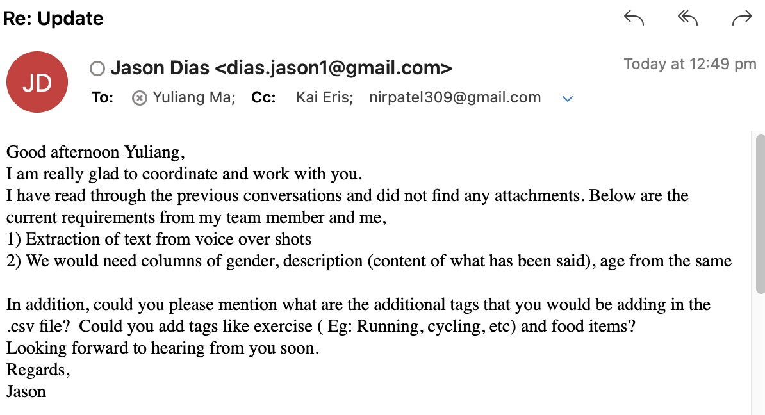
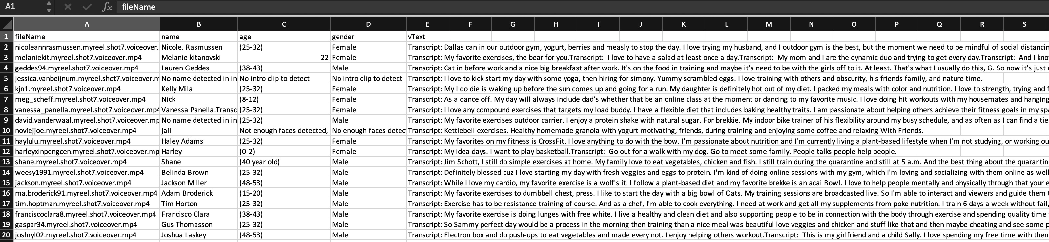
Demo 2
· Why did we build demo 2 ?
- By plan
- Client's requirements
· What does the result look like ?

Slide 13
Demo 2
· Why did we do in demo 2 ?
Corresponding information from different source files
Integrations of the output from last semester and this semester
Some technical details
Special cases
Missing values
Error handling

Slide 14
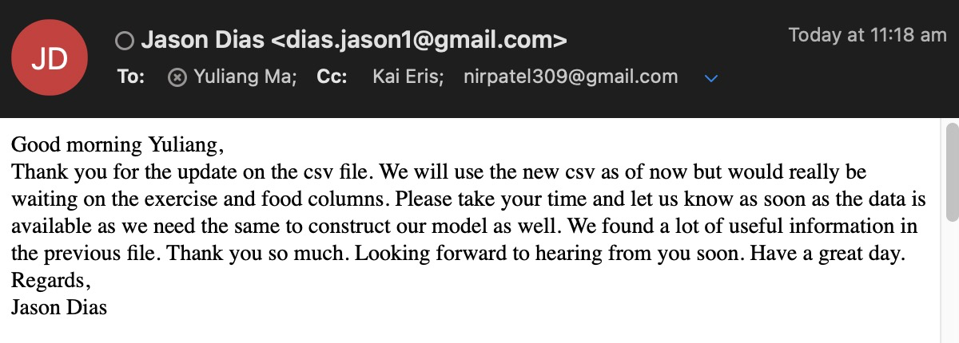
Demo 2
· Is the client satisfied ?
- Yes, it works !

Slide 15
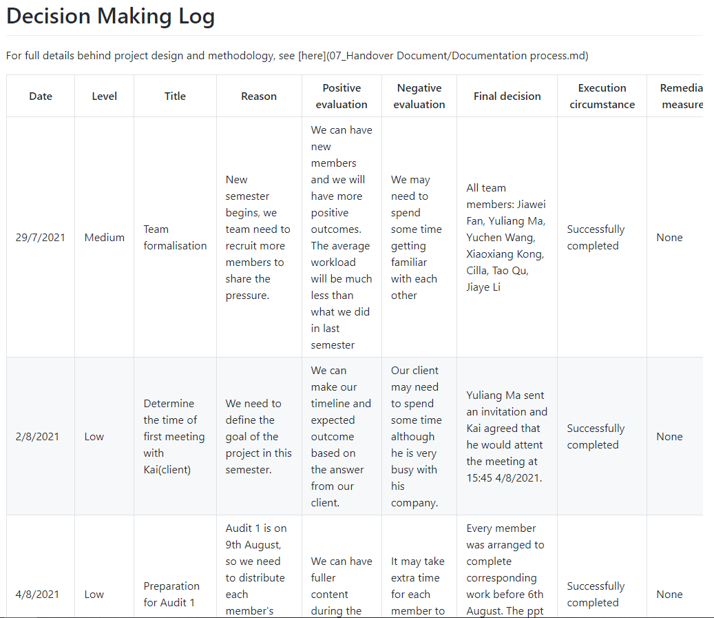
04
Decision making
By Jiawei

Slide 16
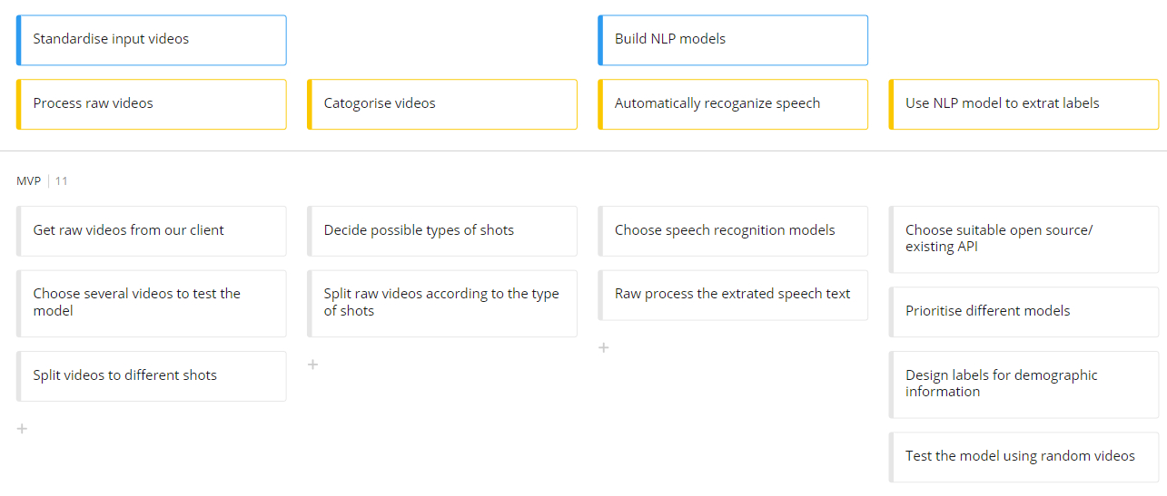
Technical aspect
Release 1/MVP

Slide 17
Technical aspect
Technology | Pros | Cons
Julius | Real-time analysis, low memory use | Usually used in linux distribution
Kaldi | Extendable and modular | Relatively low performance
Google speech to text service | Robust, easy to use | Relatively high subscription fee
Amazon comprehend | State-of-art natural language processing service | Relatively high subscription fee

Slide 18
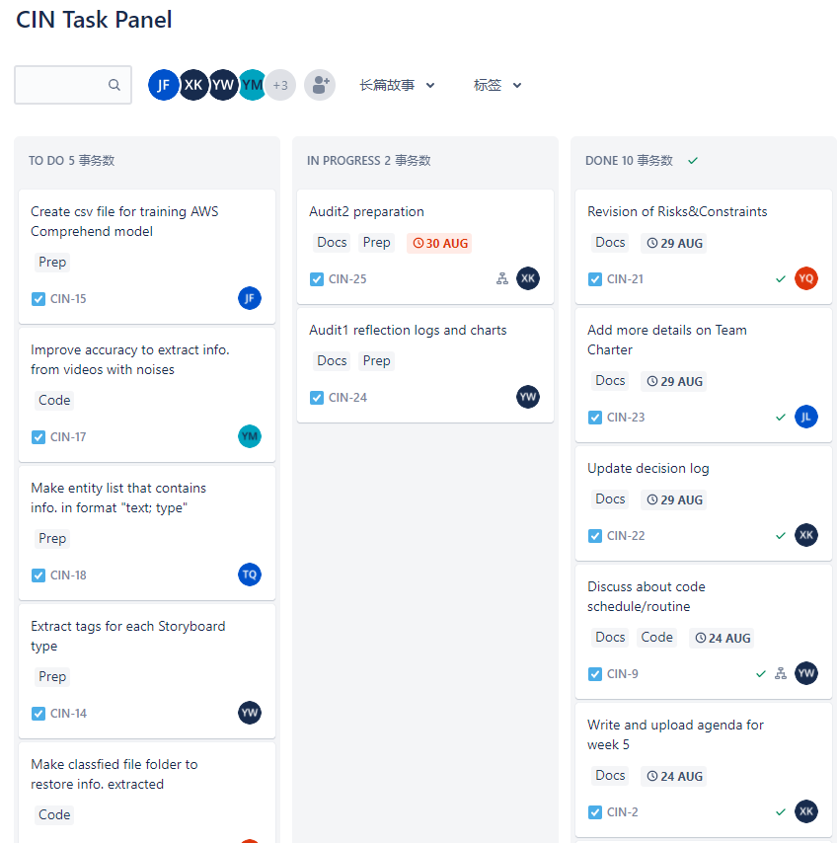
Project management aspect
1. Easily track the progress of the tasks
2. Remind us of meeting the deadlines

Slide 19
05
Teamwork
By Jiaye

Slide 20
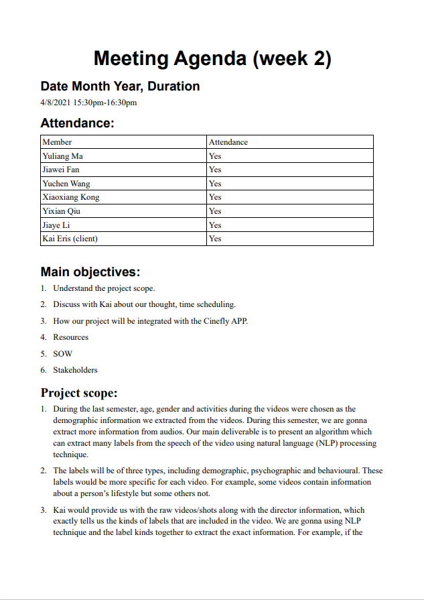
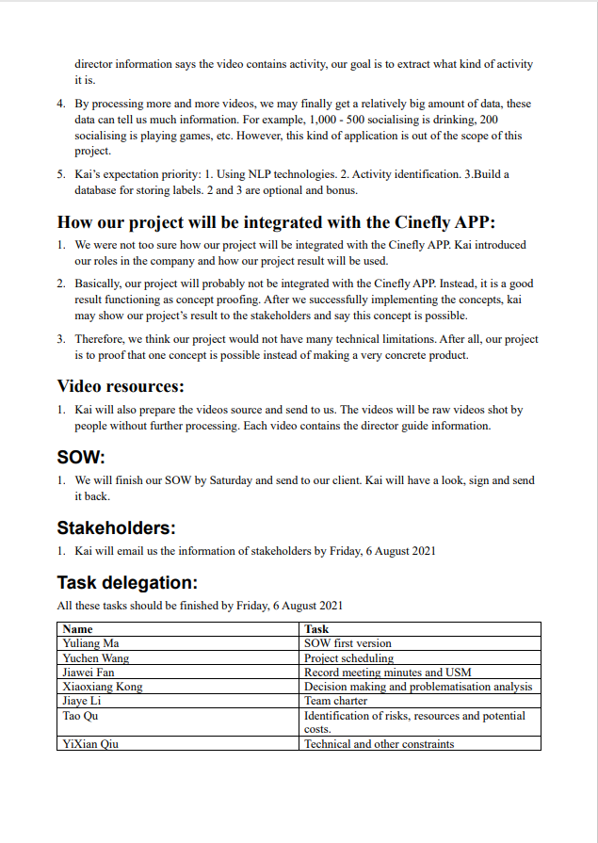
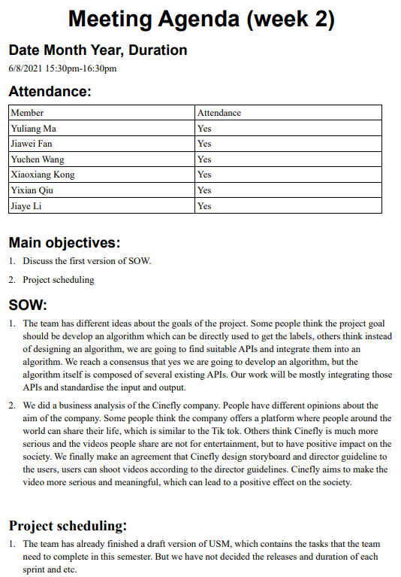
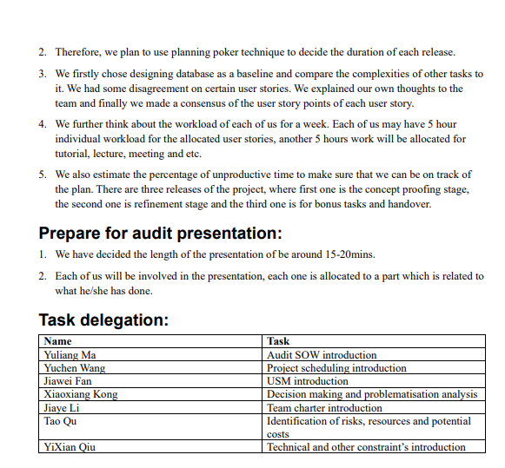
Meetings
Team Meetings
Task progress and planning
All members expected
Client Meetings
Reporting and adjustments
Spokesperson required
Tutorial
Reporting
All members expected

Slide 21
Ground Rules
Attend scheduled meetings.
Actively contribute to the project.
Engage with other team members.
Work closely with the client to ensure requirements are met.
Treat each other with respect.
Rules on collaboration.

Slide 22

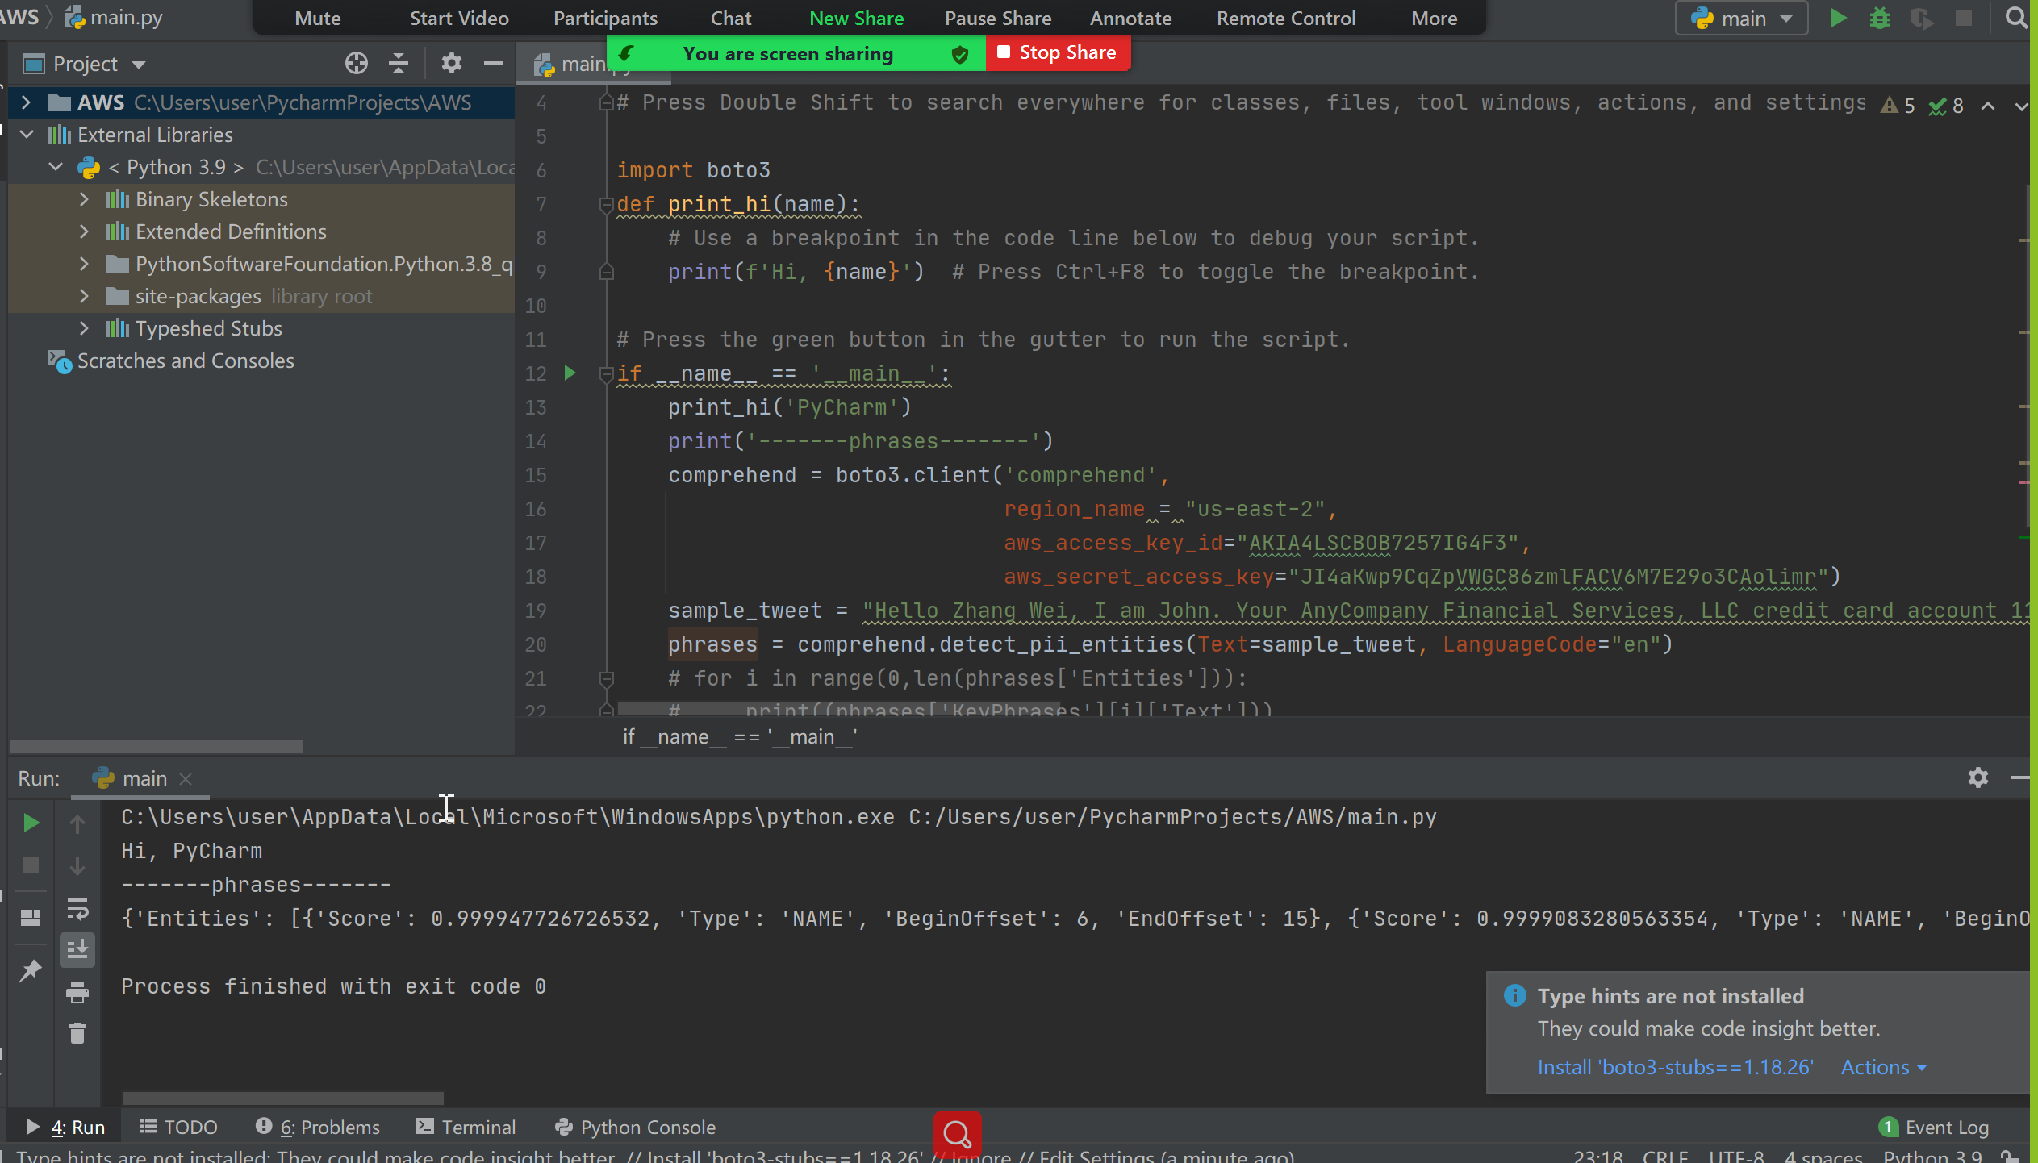
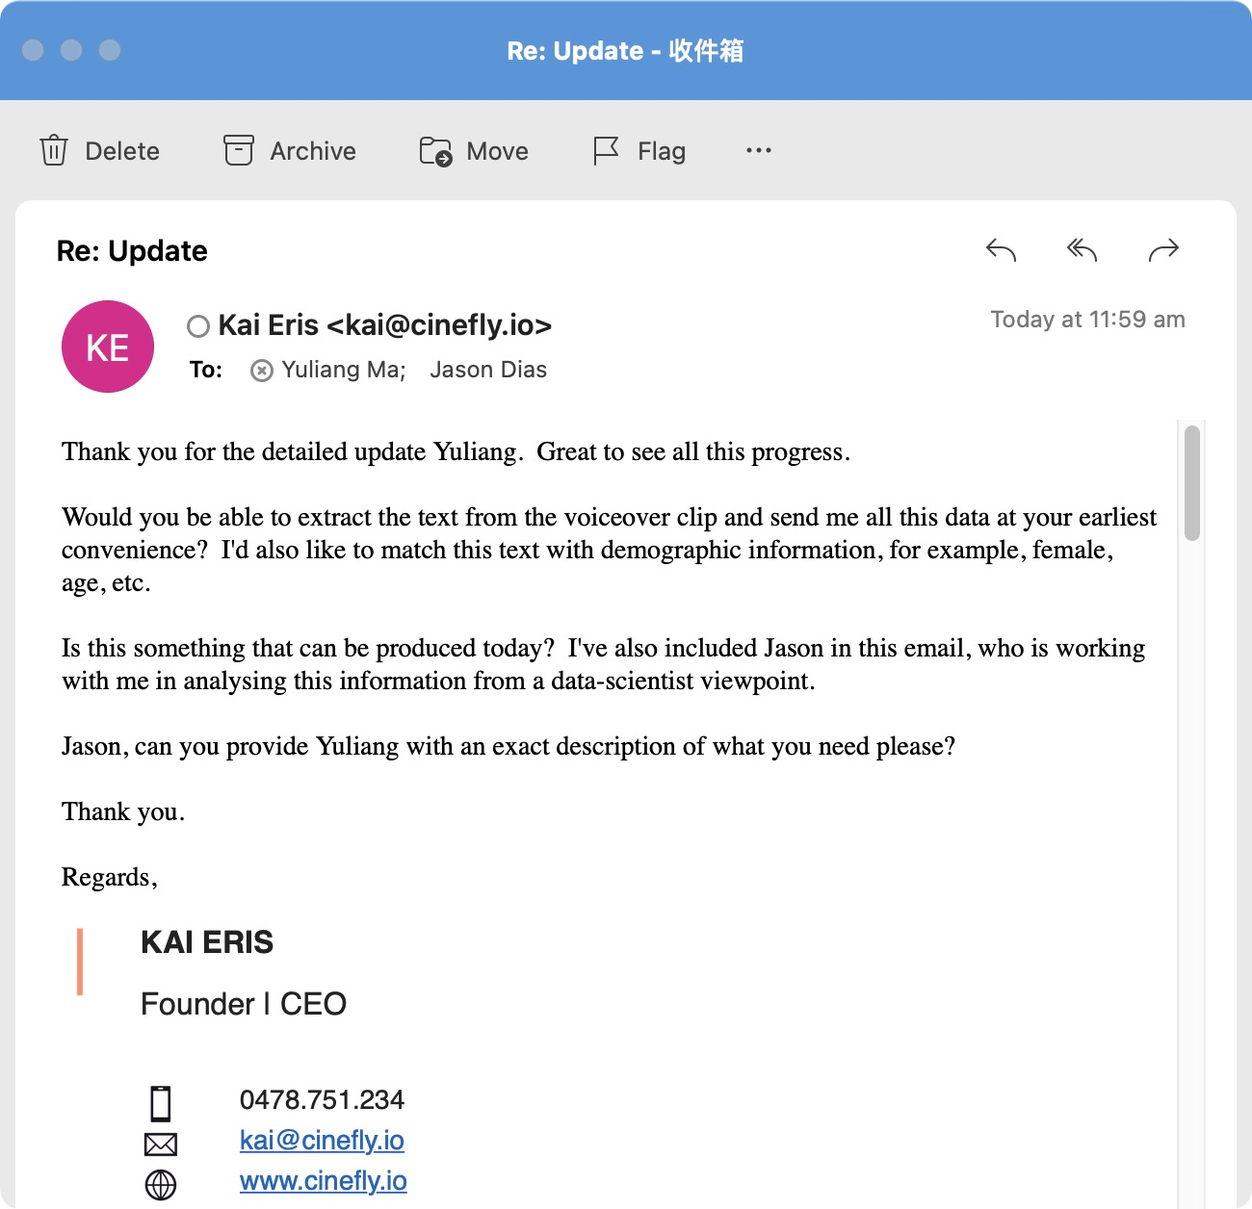
Team Collaboration

Slide 23
06
Communication
By Xiaoxiang Kong

Slide 24
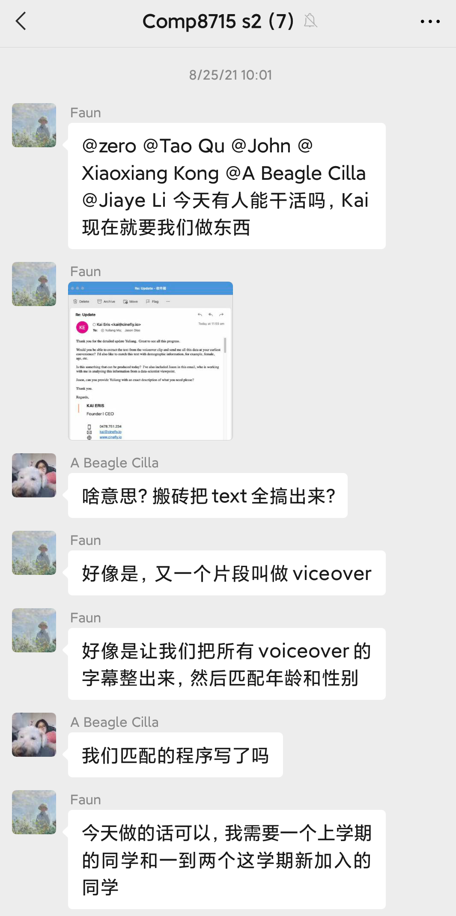
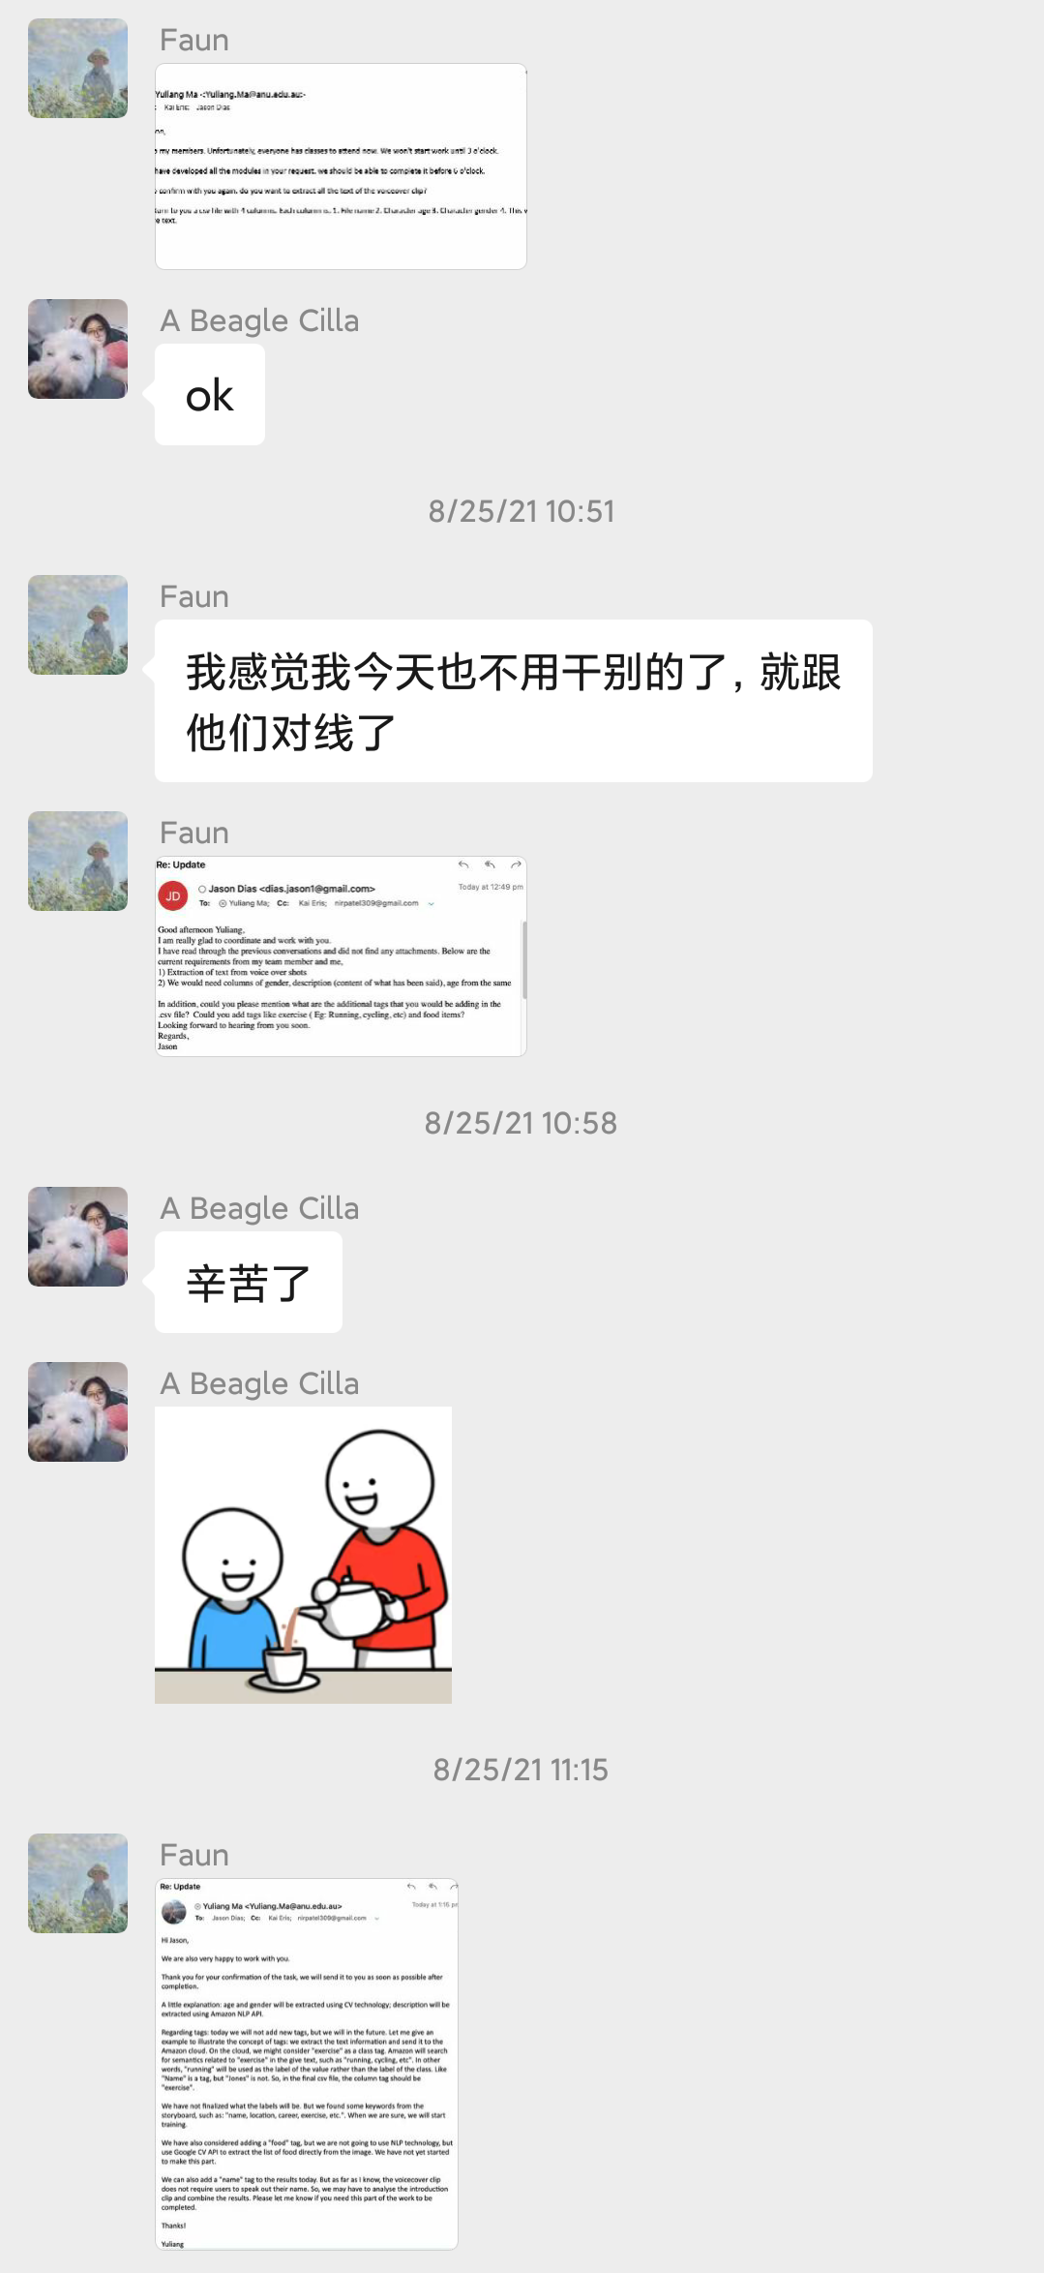
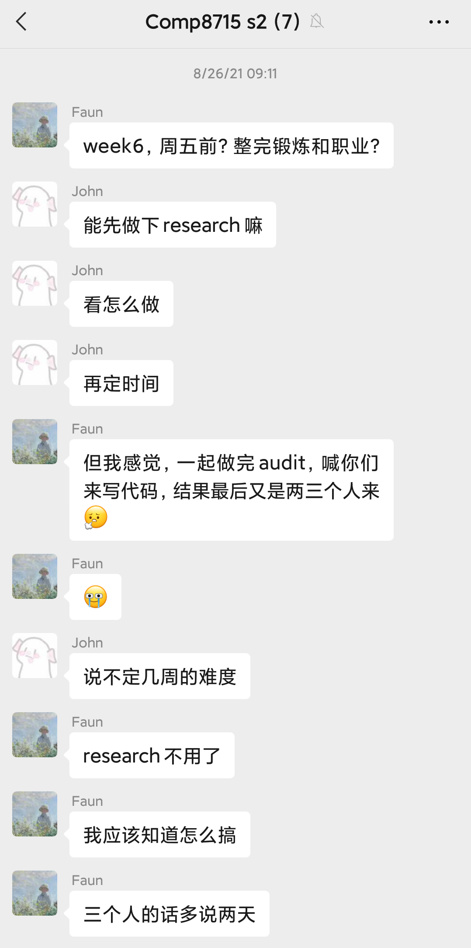
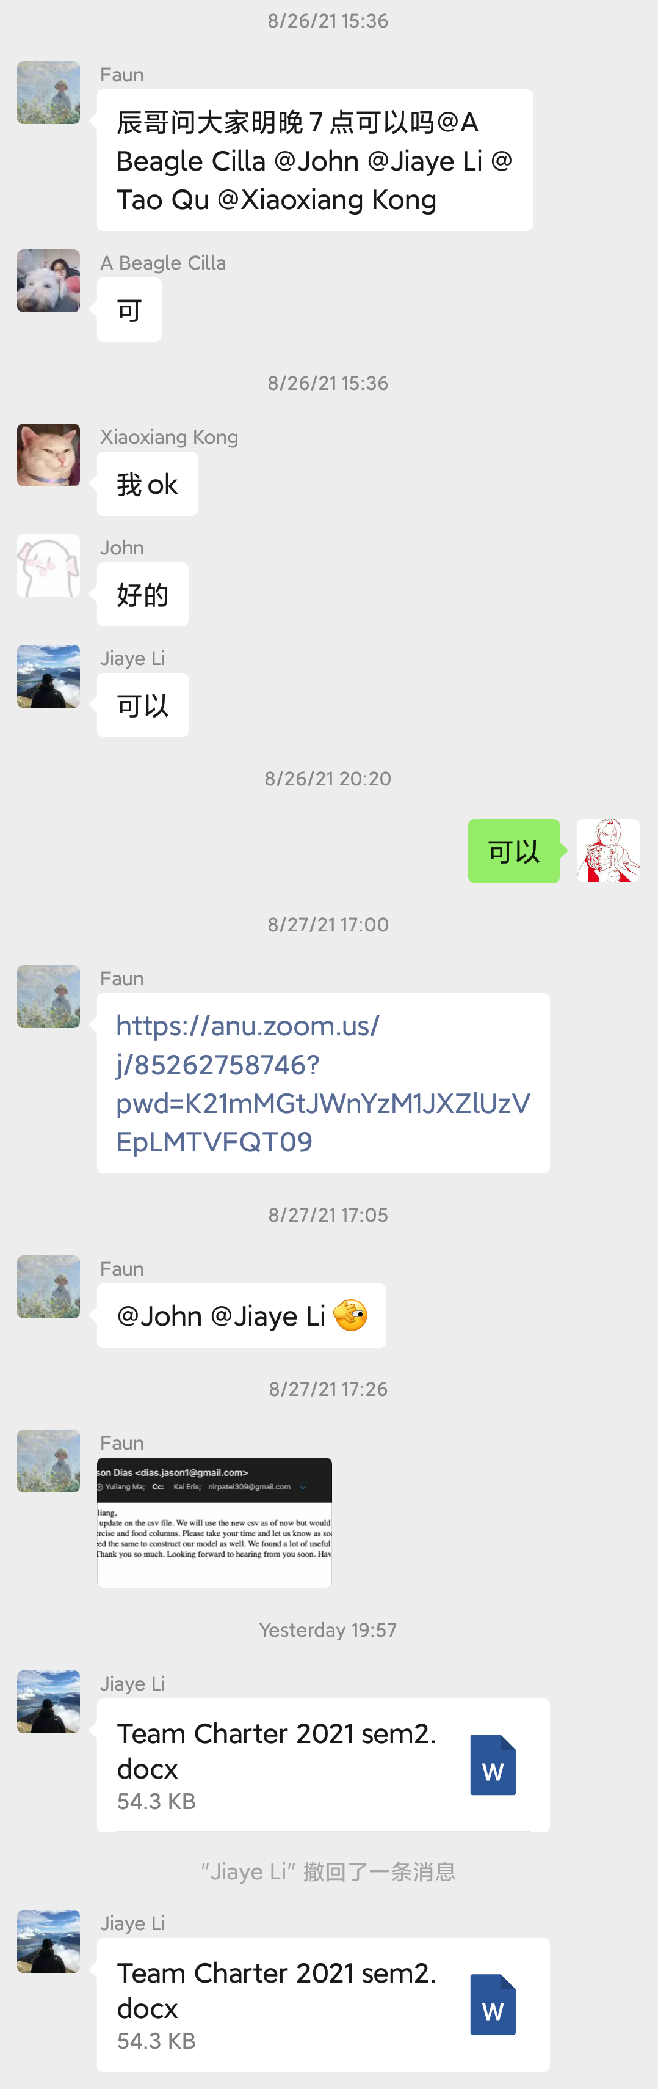

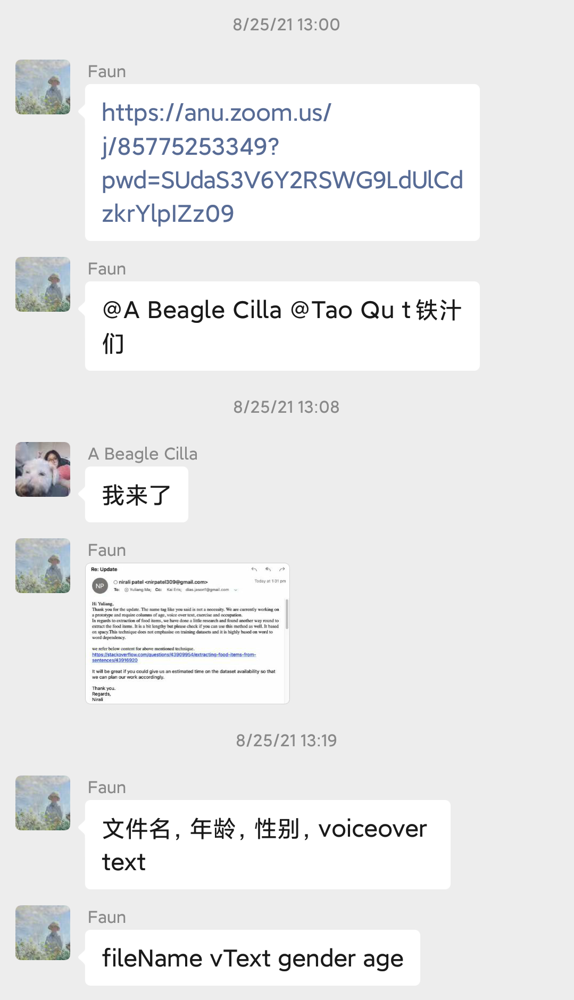
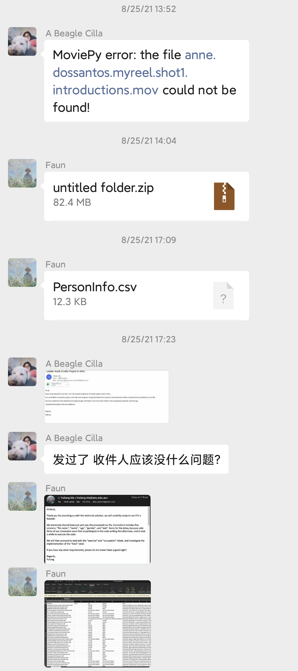
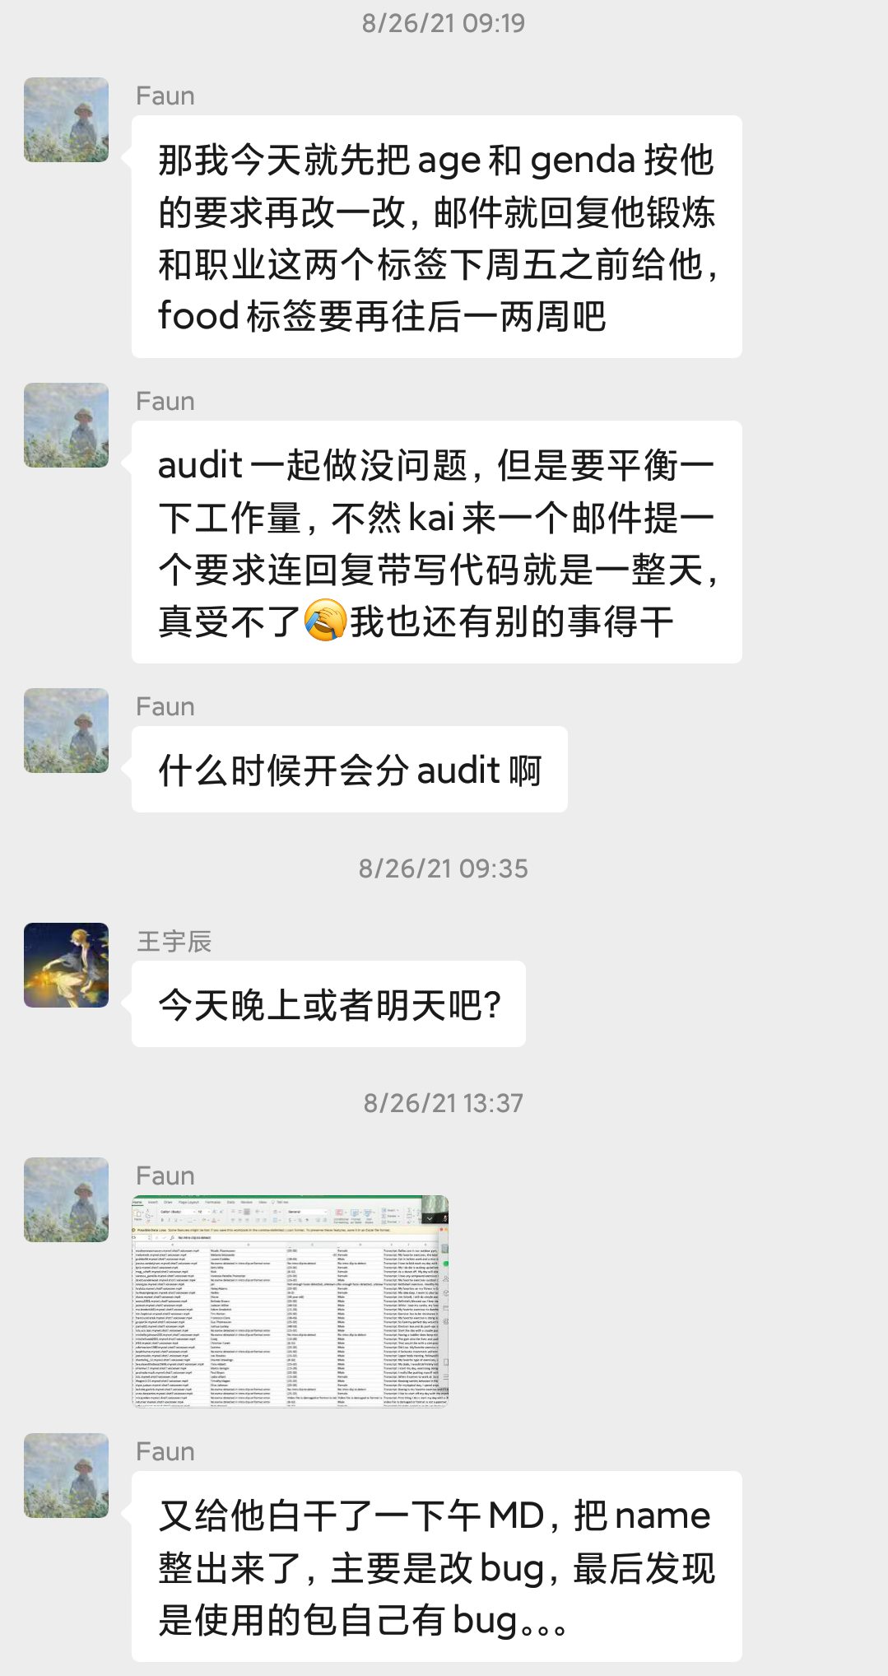
Communicating approaches (within our team)
.

Slide 25
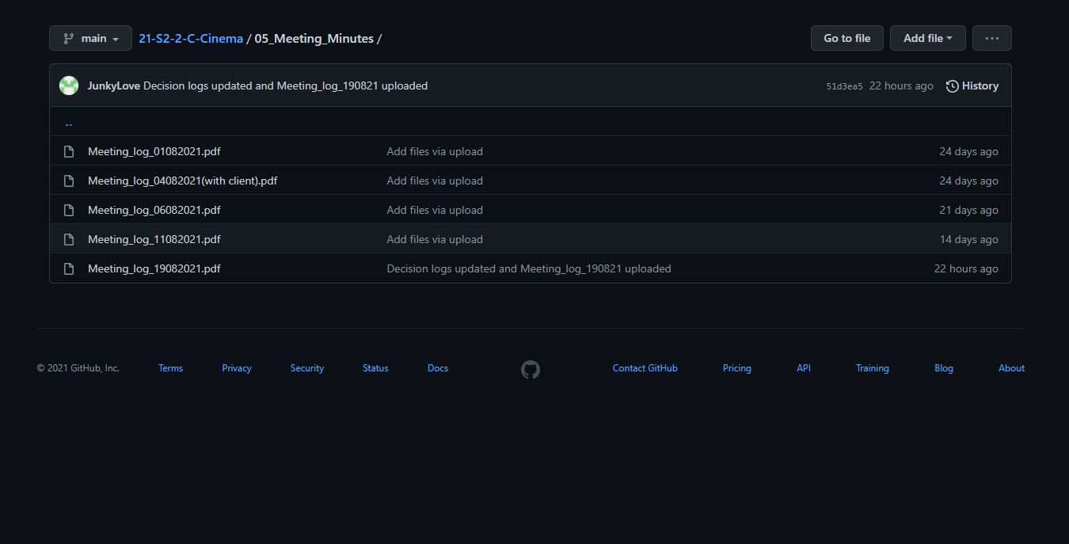

Communicating approaches (within our team)
2.

Slide 26
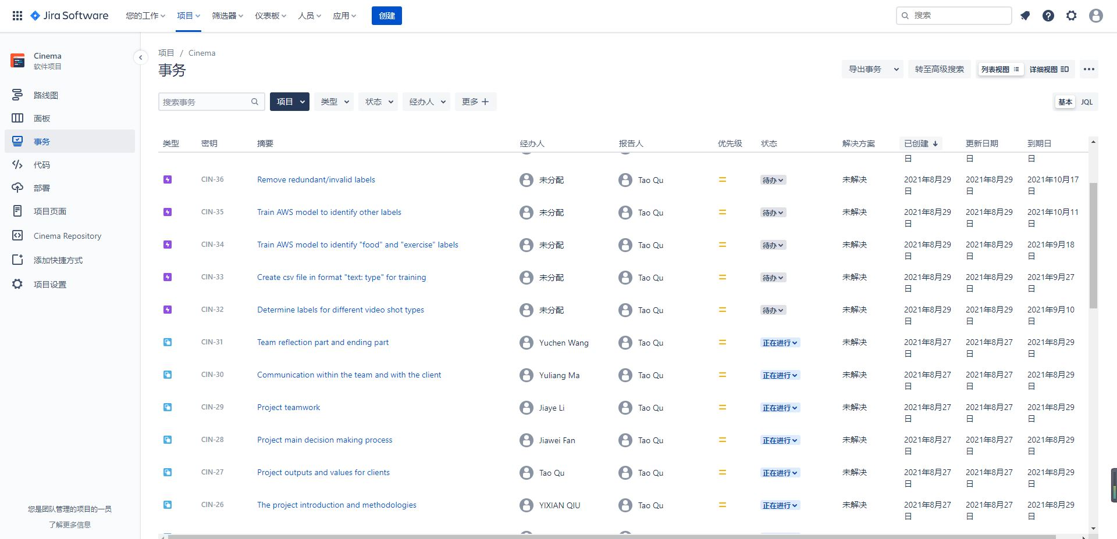

Communicating approaches (within our team)
3.

Slide 27
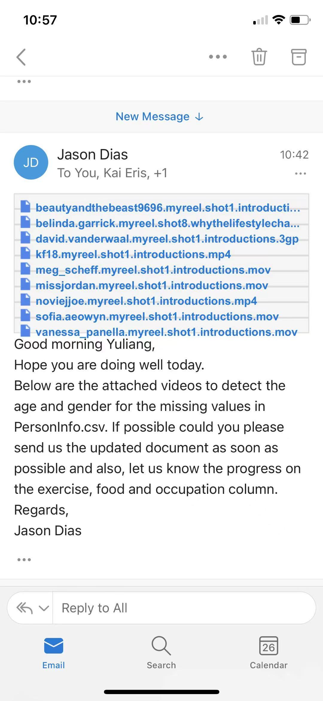
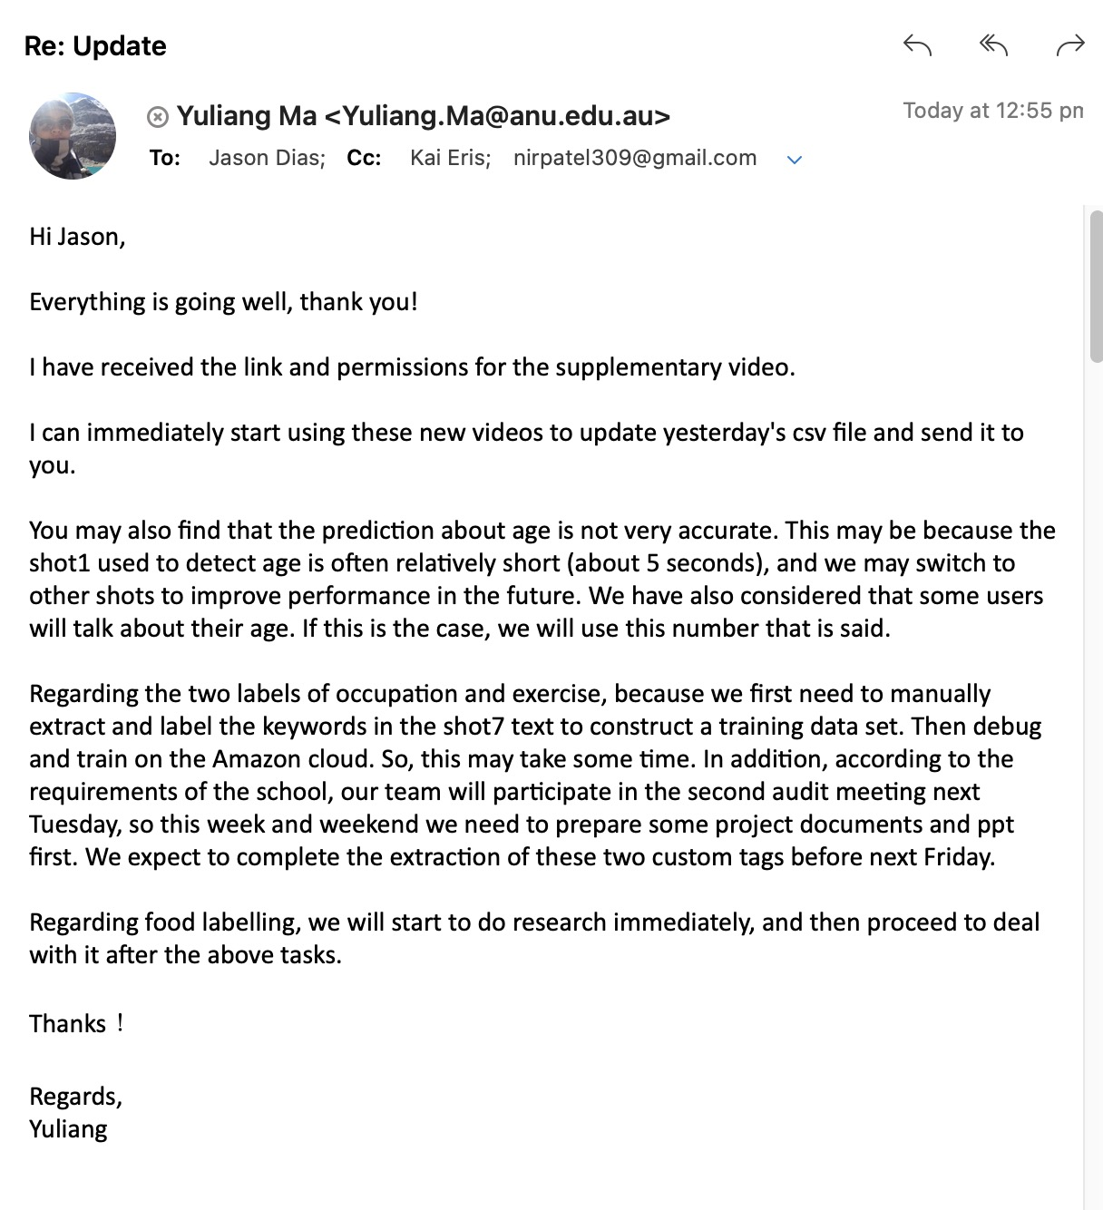
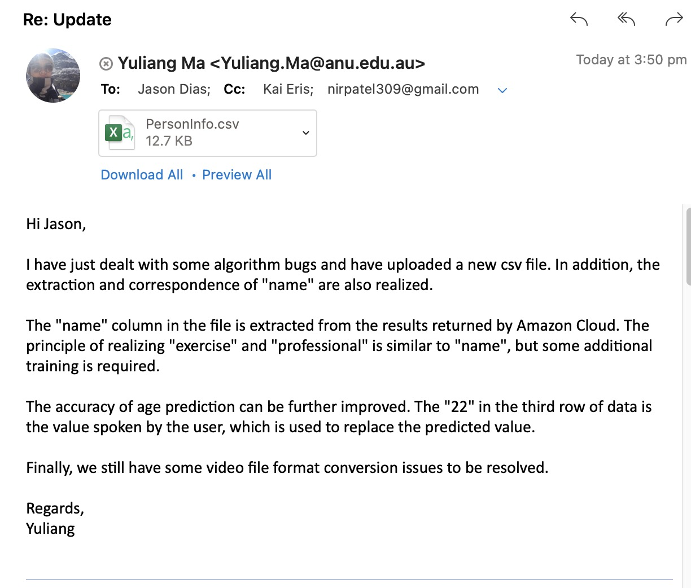

Communicating approaches (with our client)

Slide 28
07
Reflection
By Yuchen Wang

Slide 29
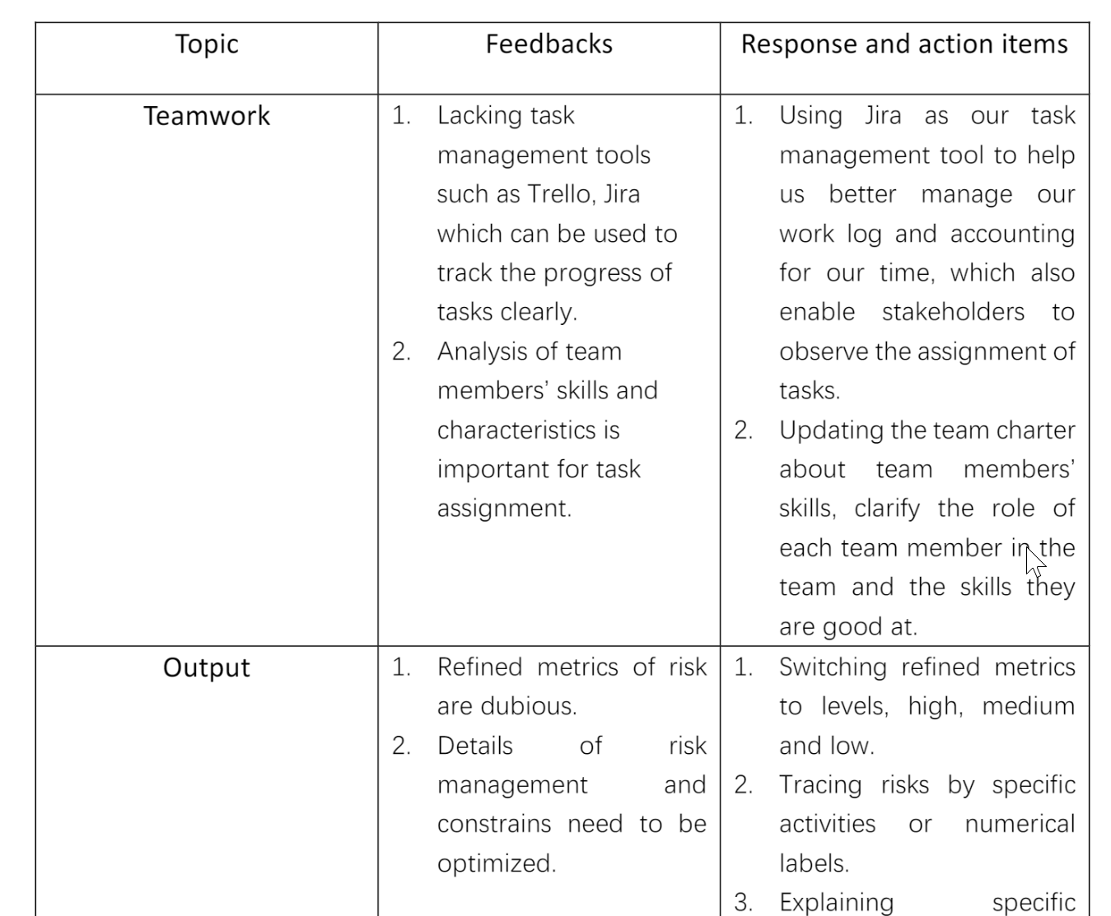
Reflection
Reflection-Audit 1
Teamwork
Output
Feedbacks
Reflection
Decision making
Communication

Slide 30
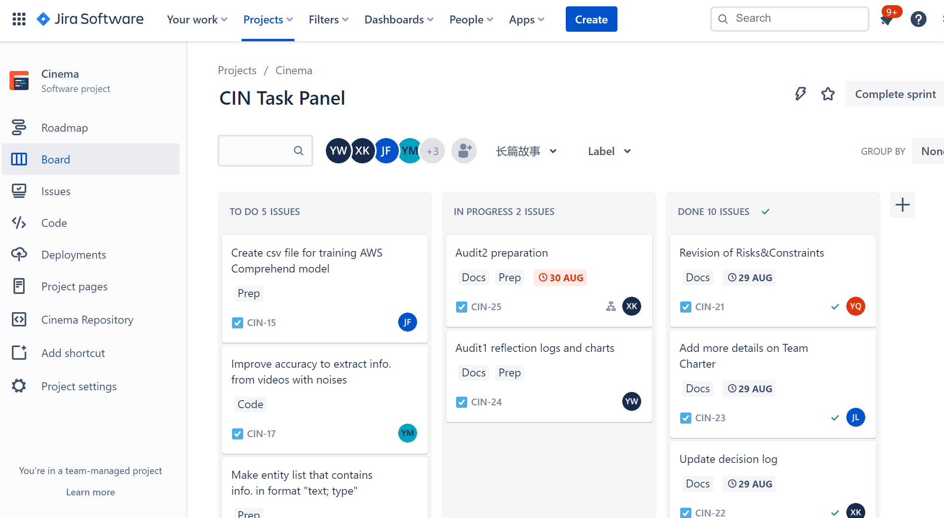
Reflection
Task management tool: Jira

Slide 31
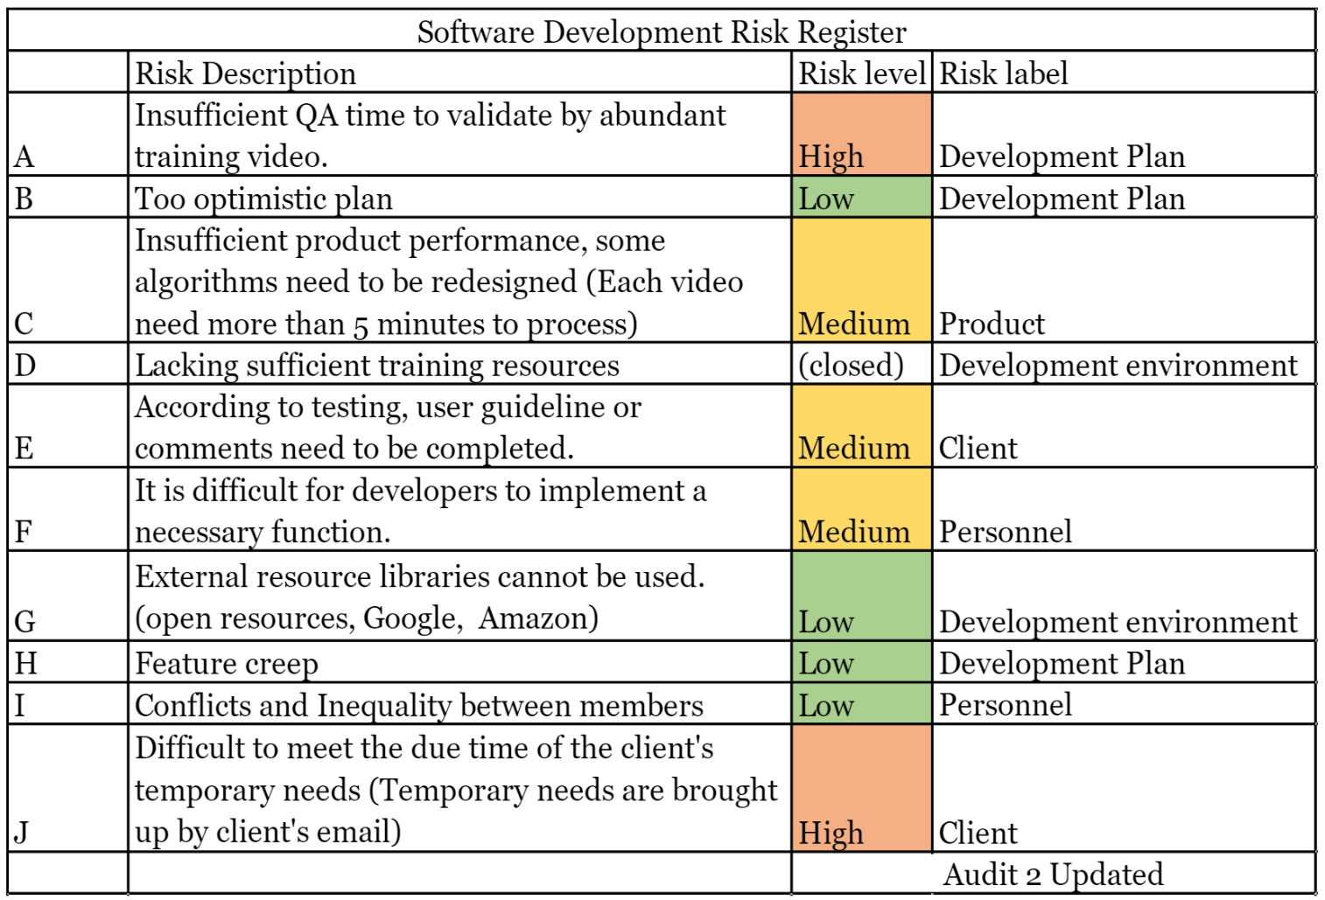
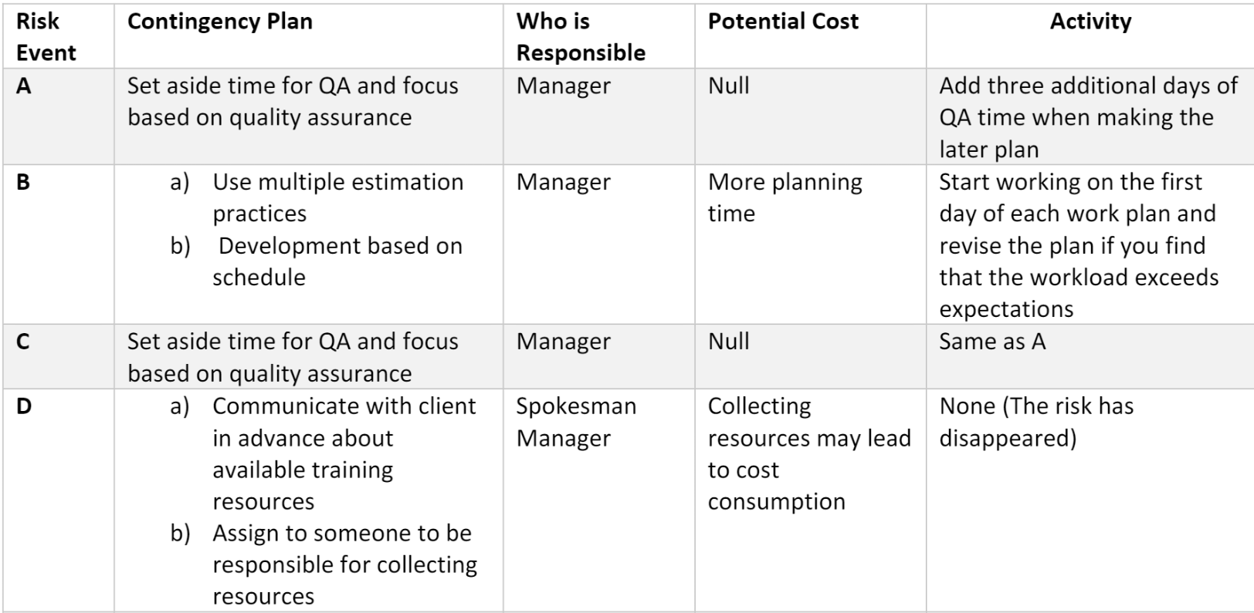
Reflection
Risk management

Slide 32
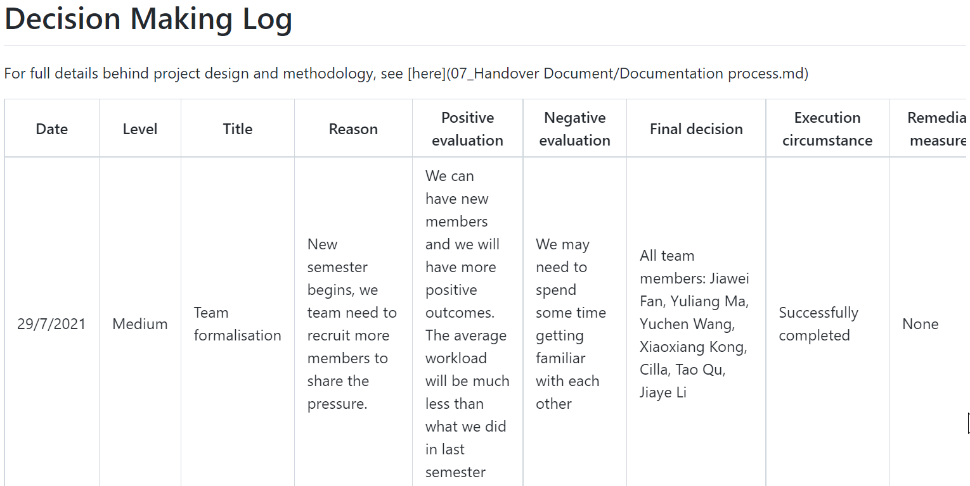
Reflection

Slide 33
Thanks for Listening

